Slide 1

Descriptions and Applications
Of
Popular Deep Learning Framworks
Liqi
lq@mpig.com.cn
Machine Perception and Interaction Group (MPIG) www.mpig.com.cn

Slide 2
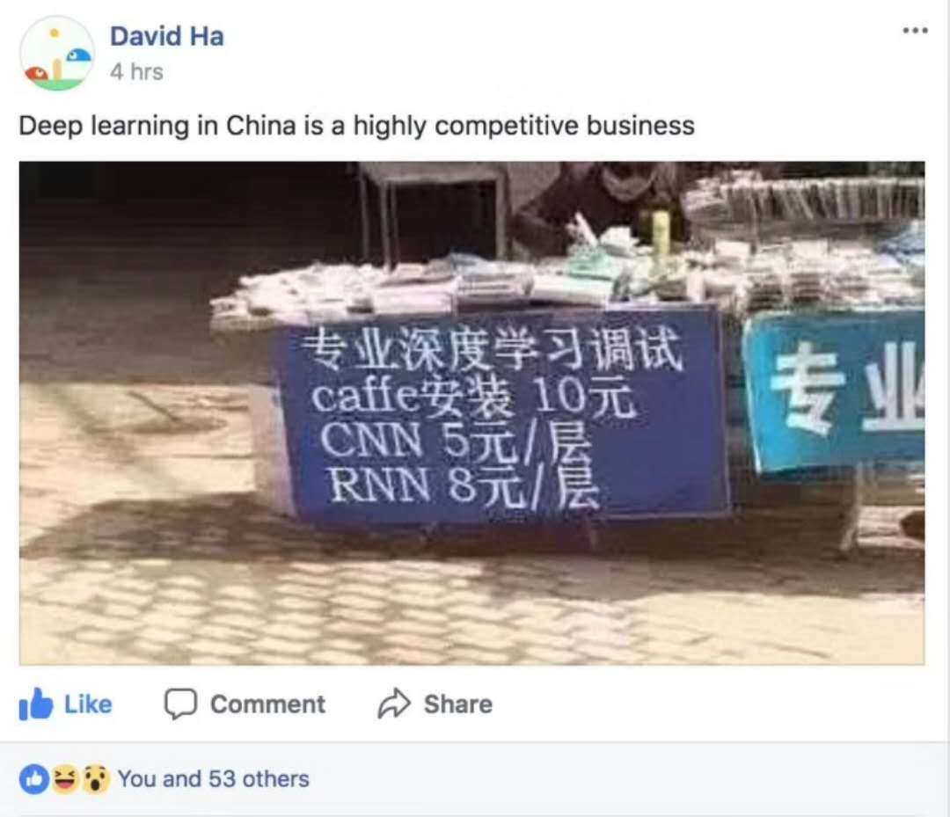

Slide 3
1. What’s Deep Learning Frameworks
2. How to use Popular Frameworks
3. Examples

Slide 4
1. What’s Deep Learning Frameworks

Slide 5
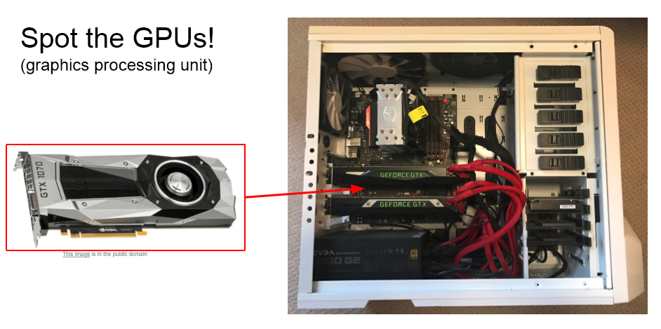

Slide 6

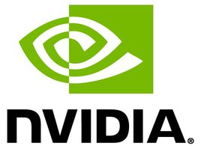
X
https://www.nvidia.cn/object/what-is-gpu-computing-cn.html

Slide 7
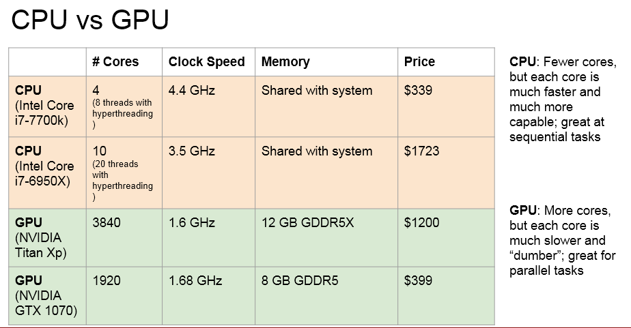

Slide 8
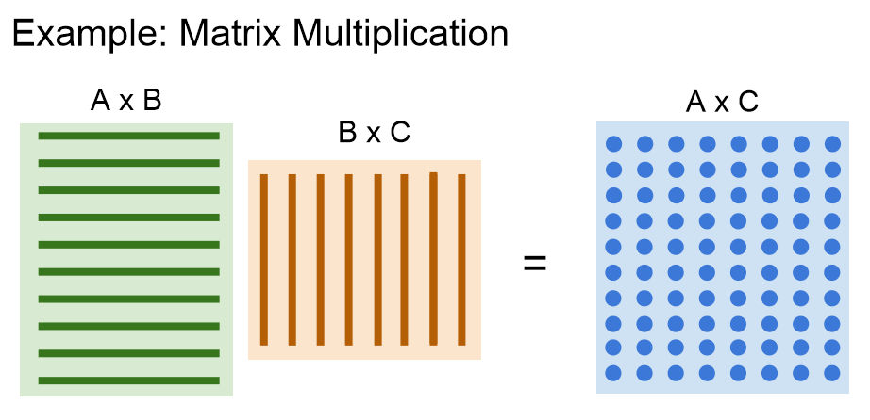

Slide 9
Programming GPUs
● CUDA (NVIDIA only)
○ Write C-like code that runs directly on the GPU
○ Higher-level APIs: cuBLAS, cuFFT, cuDNN, etc
● OpenCL
○ Similar to CUDA, but runs on anything
○ Usually slower :(
● Udacity: Intro to Parallel Programming https://www.udacity.com/course/cs344
○ For deep learning just use existing libraries

Slide 10
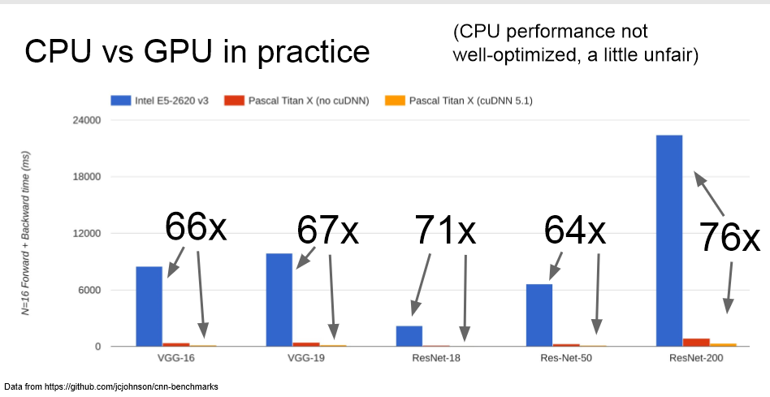

Slide 11
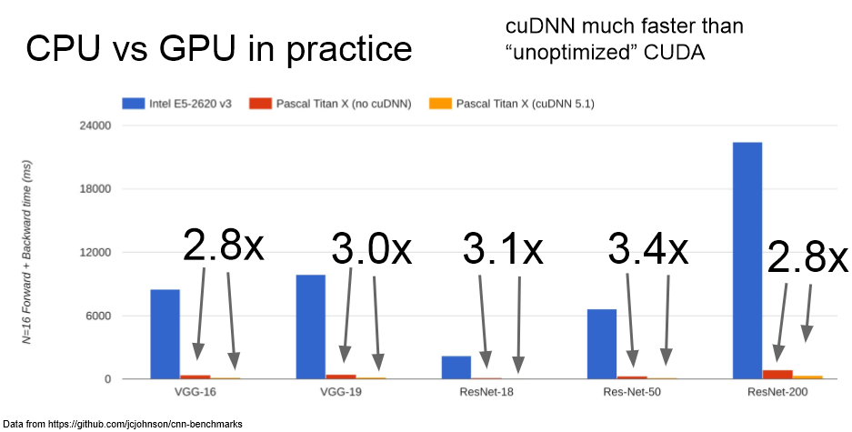

Slide 12
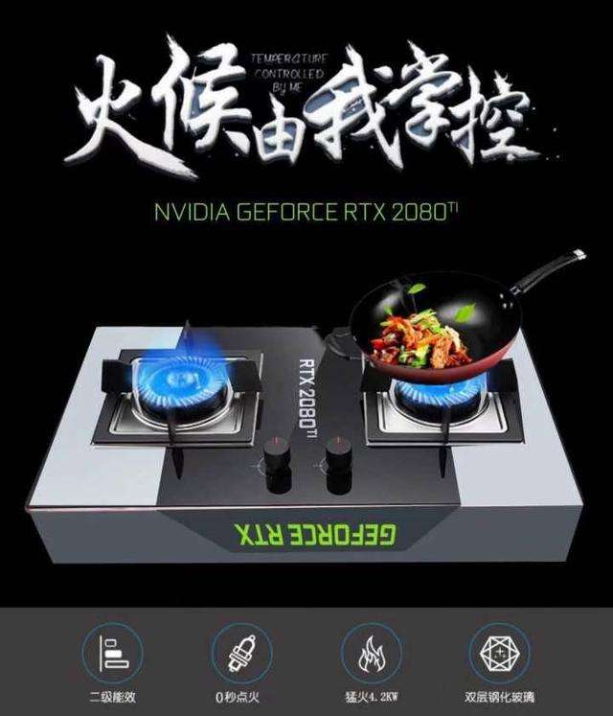
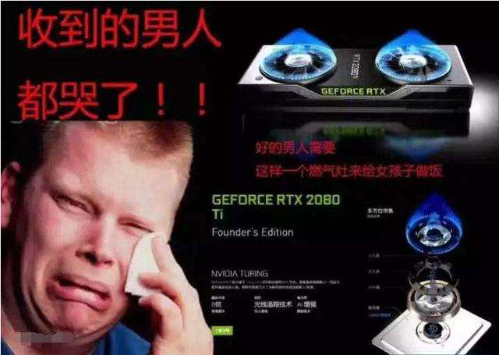
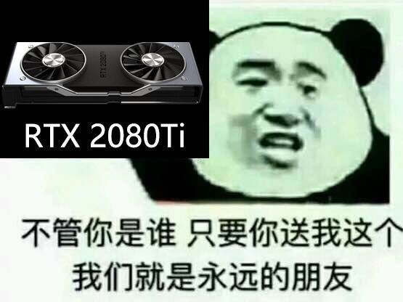

Slide 13
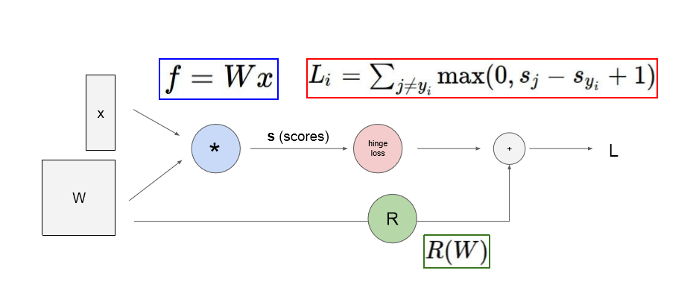
Computational Graphs

Slide 14
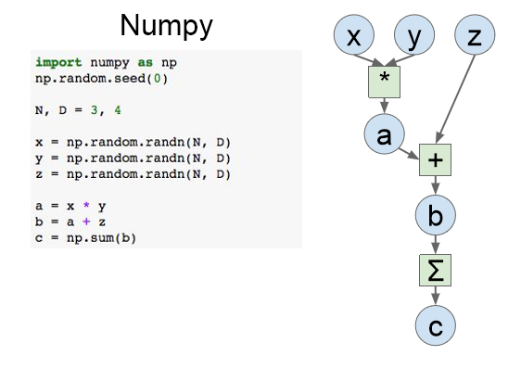

Slide 15
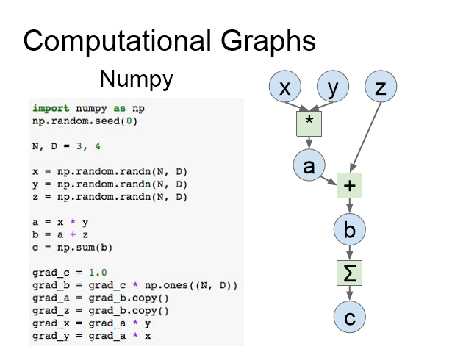
Problems:
Can’t run on GPU
Have to compute our own gradients

Slide 16



Caffe (UC Berkeley)
Caffe2 (Facebook)
Torch (NYU / Facebook)
PyTorch (Facebook)
Theano (U Montreal)
TensorFlow (Google)
Keras
MXNet (Amazon)
Developed by U Washington, CMU, MIT, Hong Kong U, etc but main framework of choice at AWS

Slide 17

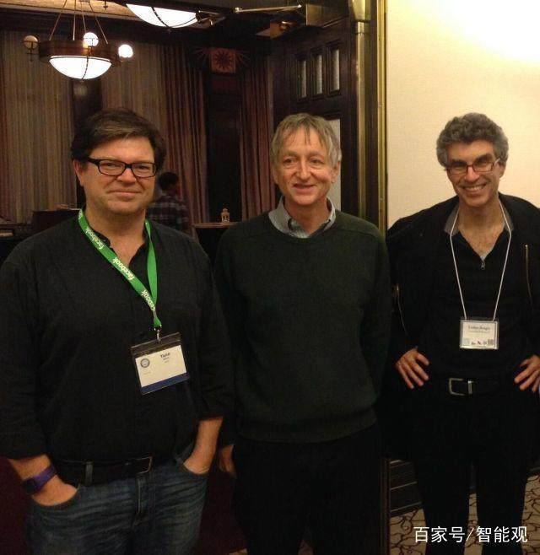
Université de Montréal
https://github.com/lisa-lab
First framework for deep learning!
2017.9.28，Before Theano 1.0 released ，The leader of LISA Lab，One of DL “BIG3”-- Yoshua Bengio announced that “Theano is Dead”…
Ian Goodfellow has abandoned Theano
Joined in Google developing TensorFlow

Slide 18
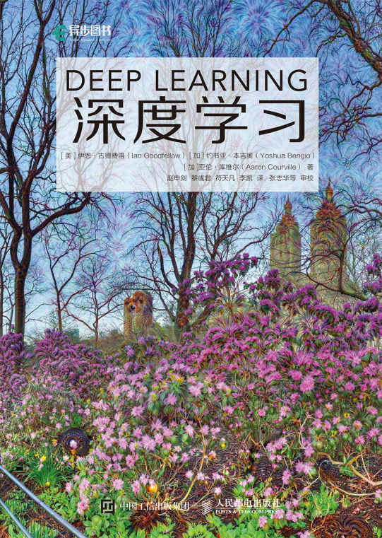
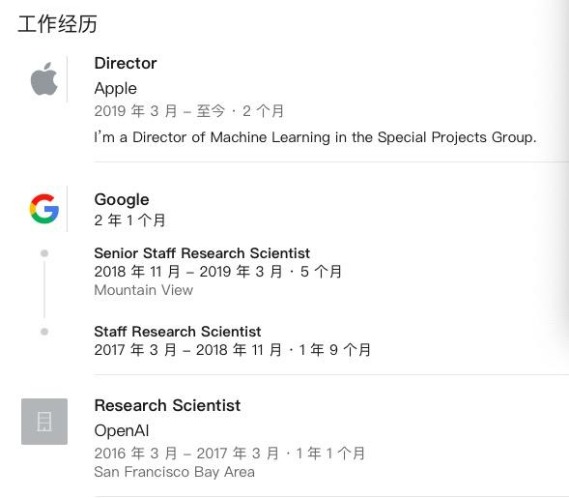
Ian Goodfellow
http://www.iangoodfellow.com/

Slide 19

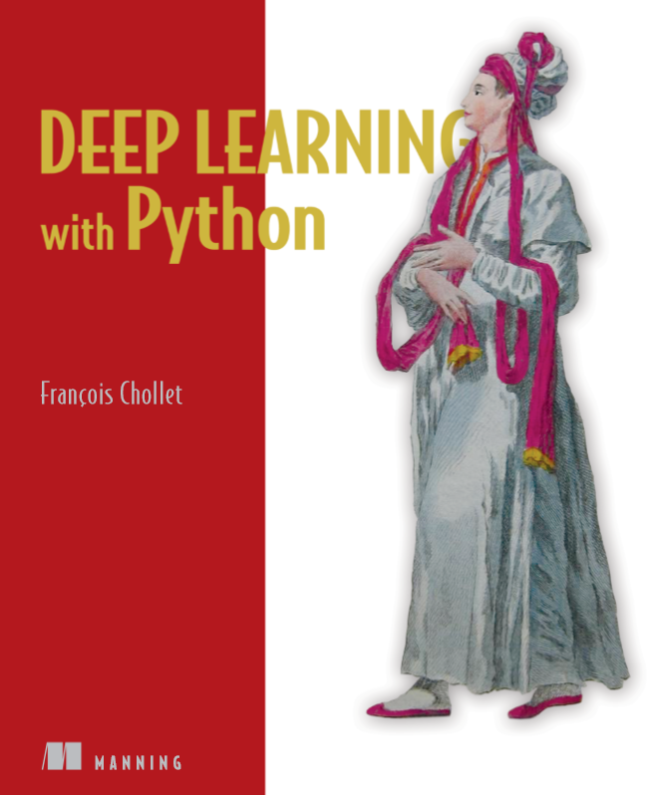
https://github.com/keras-team/keras
A high-level neural networks API
Written in Python
Capable of running on top of TensorFlow, CNTK, or Theano.
It was developed with a focus on enabling fast experimentation.
Inflexible
Just for newcomer…Not suitable for deep-going

Slide 20

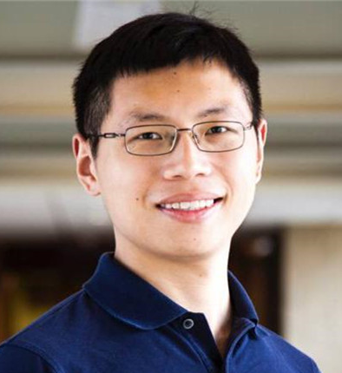
https://github.com/apache/incubator-mxnet
Borned in DMLC（Distributied （Deep） Machine Learning Community）
2016.11,MXNet was officially chosen by AWS as its official deep learning platform for Cloud Computing. 2017.01,The MXNet project entered the Apache Foundation and became Apache's incubator project.
C++、Python、R、Scala、Julia、MATLAB and JavaScript…Most languages support.
Super incubator support.
Obvious memory and video memory optimization!
Suitable for AWS cloud platform.
Confused Documentation
Too many iterations to learn.

Slide 21
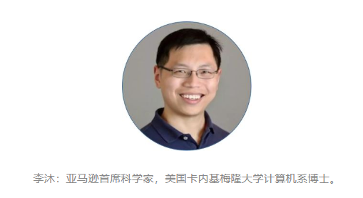
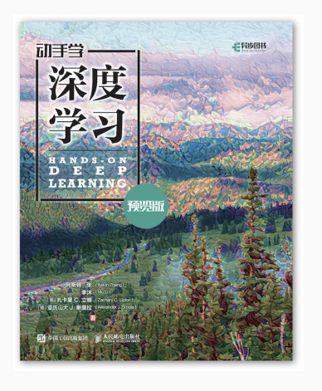
“本书的初稿在中国科学技术大学、上海财经大学的“深度学习”课程以及浙江大学的“物联网与信息处理”课程和上海交通大学的“视觉识别的卷积神经网络”课程中被用于教学。”
《动手学深度学习》
视频课程：https://discuss.gluon.ai/t/topic/753
中文文档：http://zh.gluon.ai/
在线预览：https://zh.diveintodeeplearning.org/index.html
Github项目地址：https://github.com/diveintodeeplearning/d2l-zh

Slide 22
https://github.com/Microsoft/CNTK
APIs for: Skype，Cortana，Bing，Xbox
Strong Performance! Especially in NLP.
C++ Python C# Java…
Positive community for China.. Little issues on stackflow..

Slide 23


APIs come from torch
https://pytorch-cn.readthedocs.io/zh/latest/
Elegant simplicity
Flexible
Easy-using
Chinese document
Active community
…

Slide 24

Most popular framework!
Generation of Theno
Java Go Python C++
Win7, Win10 ,Win server and Andriod support
Chinese document and lessons
Active community
Complex and huge structure(100w+ lines codes)
Miscellaneous document

Slide 25

https://github.com/BVLC/caffe
Caffe: Convolutional Architecture for Fast Feature Embedding
Written by C++. Support Python、MATLAB Simplicity and Fast
Model Zoo!
The most important abstract object in Caffe is layer.
C++ must be used to realize its forward and backward propagation code.
Inconvenient to use CUDA
Less and Less Projects
Just for Computer Vision Task!

Slide 26

https://github.com/facebookarchive/caffe2
All platform support.
Linux, Windows, iOS, Android, Raspberry Pi and NVIDIA Tegra
This repository has been archived by the owner. It is now read-only.
No Official documents

Slide 27
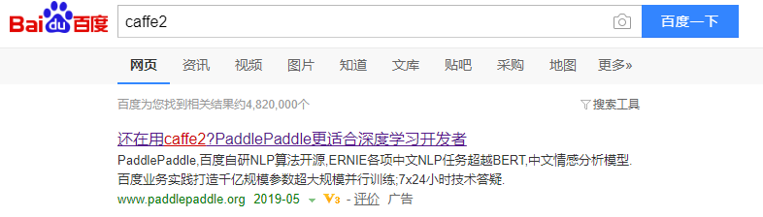
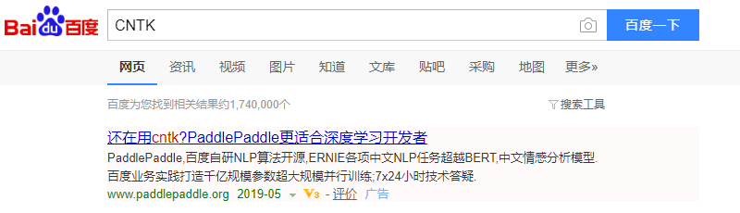

Slide 28
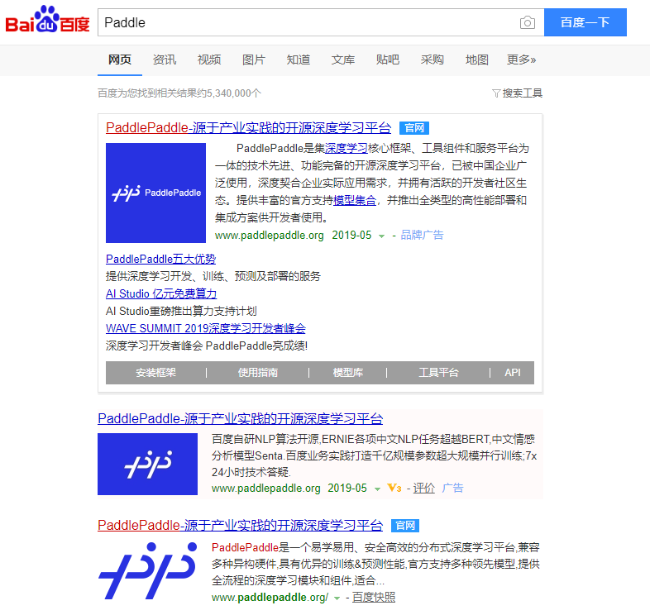

Slide 29

https://github.com/PaddlePaddle
Made in CHINA!
http://www.paddlepaddle.org/paddle

Slide 30
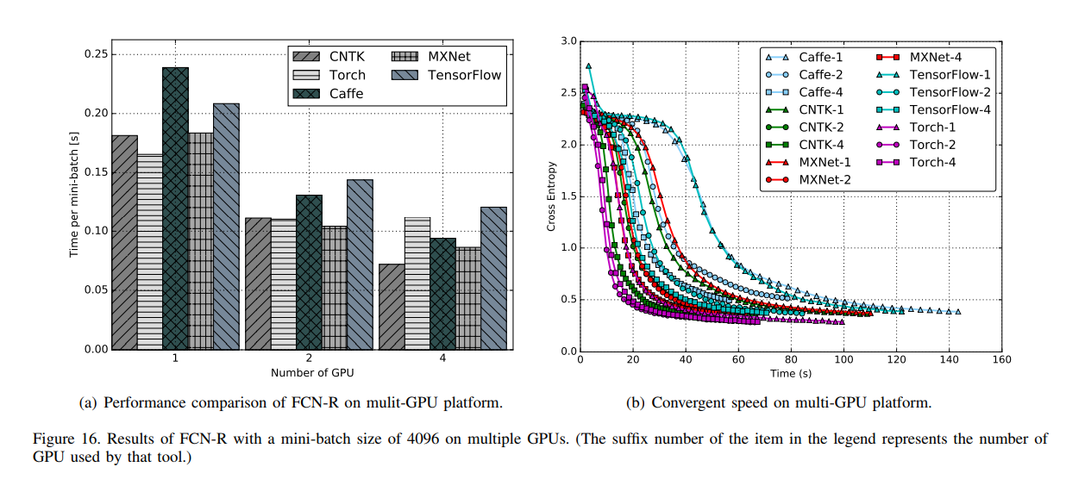
https://arxiv.org/pdf/1608.07249.pdf

Slide 31


Slide 32
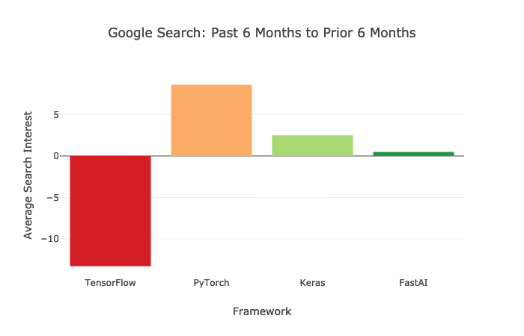
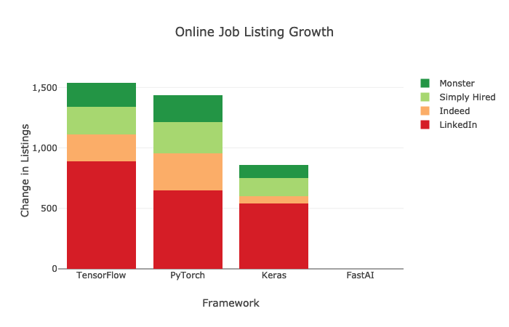

Slide 33
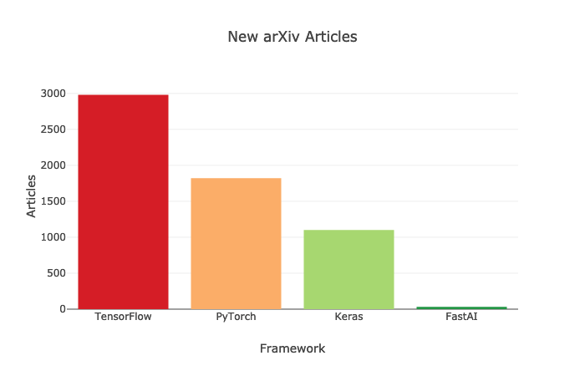

Slide 34
2. How to use Popular Deep Learning Frameworks

Slide 35
Ensure your computer has installed CUDA and CUDNN
Install proper graphics card drivers.
Install CUDA with proper version.
Install CUDNN with proper version.

Slide 36
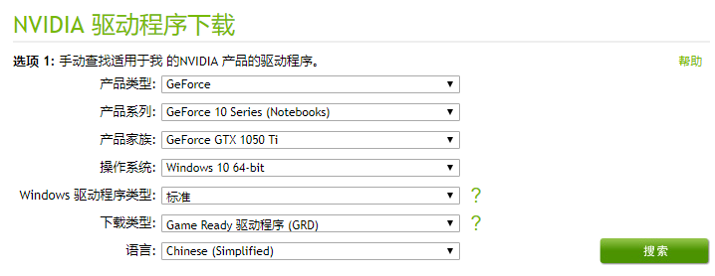

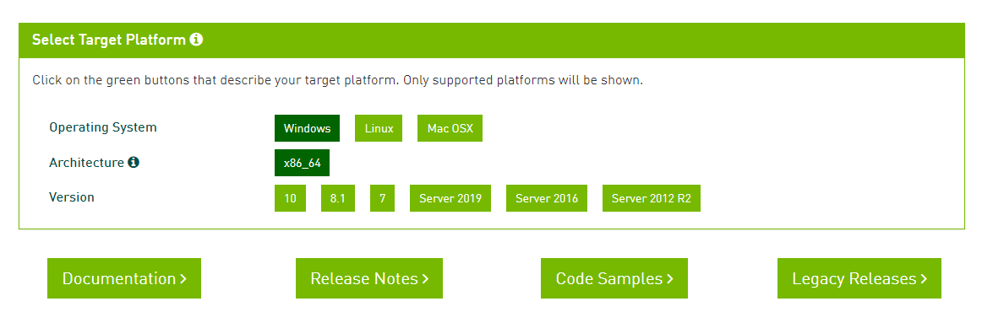
https://www.nvidia.cn/Download/index.aspx?lang=cn

Slide 37
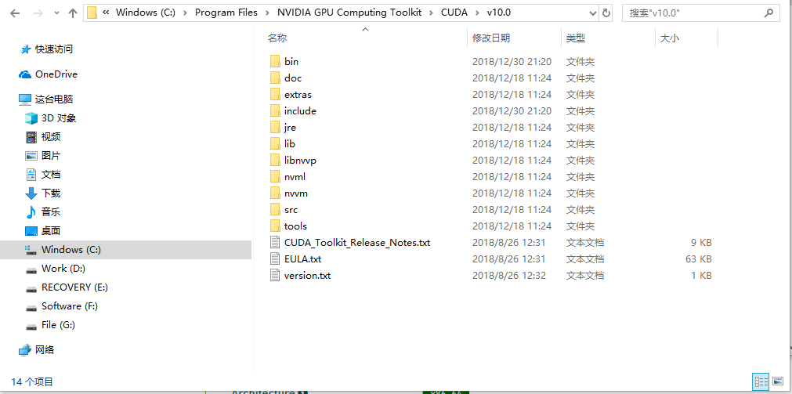
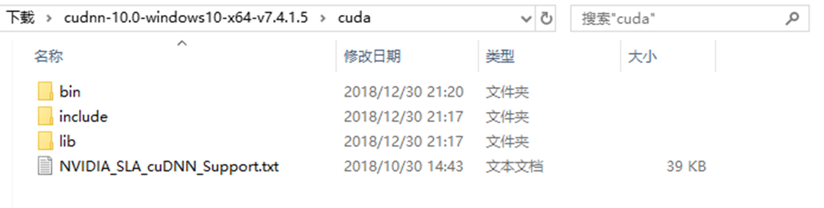
https://docs.nvidia.com/deeplearning/sdk/cudnn-install/index.html#overview

Slide 38
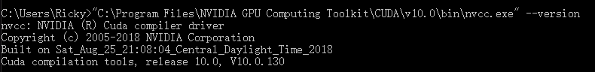
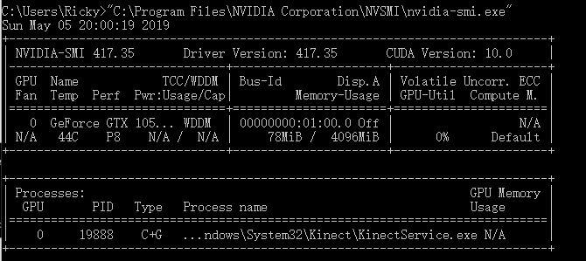

Slide 39

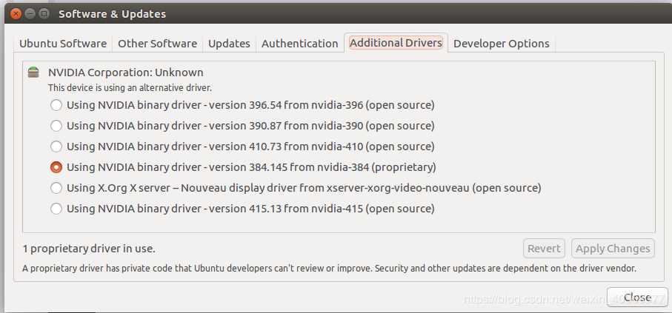
https://blog.csdn.net/weixin_40368377/article/details/84439802#

Slide 40

Envision a world where data scientists can regularly deploy AI and machine learning projects into production at scale, quickly delivering insights into the hands of decision-makers. How would that impact your business?
Anaconda Enterprise supports your organization no matter the size, easily scaling from a single user on one laptop to thousands of machines. No headaches, no IT nightmares.
Please choose Anaconda to manager your deep learning envs
https://www.anaconda.com/

Slide 41
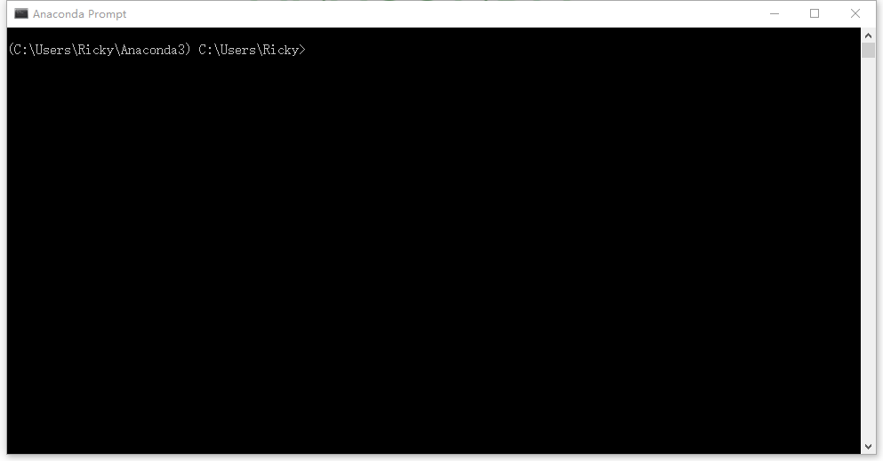
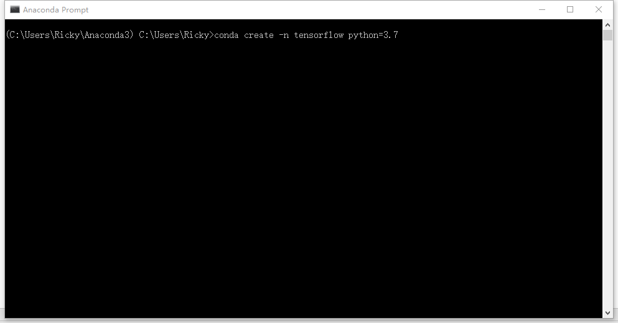
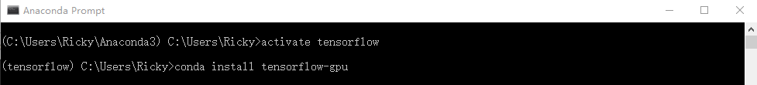
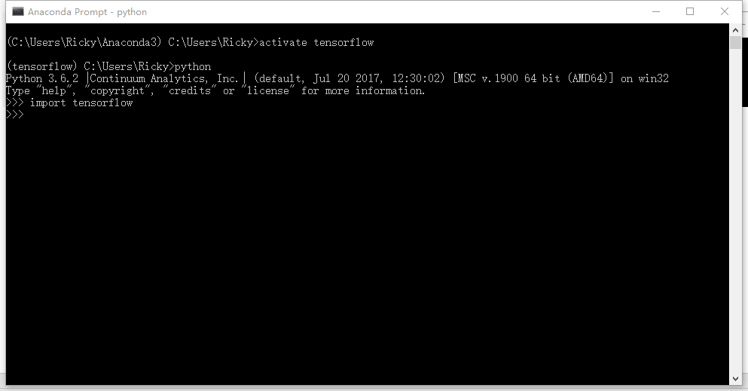

Slide 42
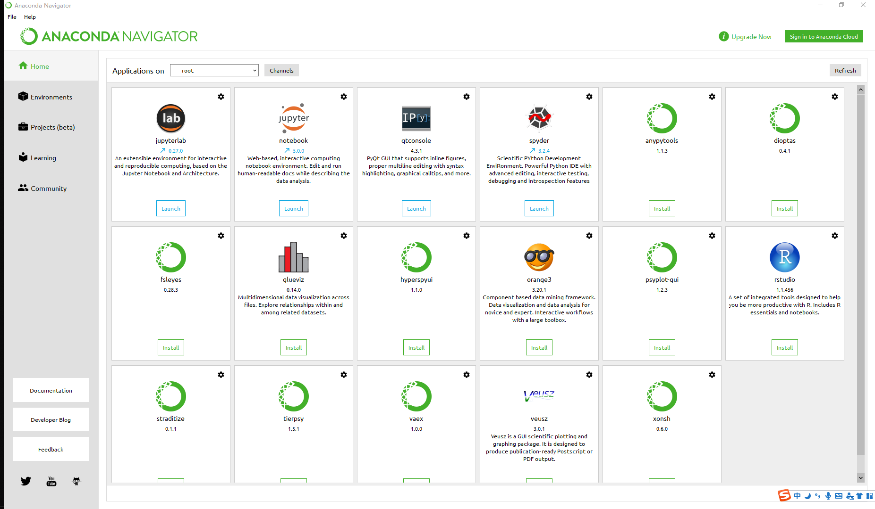

Slide 43
Set TsingHua Mirror as conda install source
conda config --add channels https://mirrors.tuna.tsinghua.edu.cn/anaconda/pkgs/free/
conda config --add channels https://mirrors.tuna.tsinghua.edu.cn/anaconda/cloud/conda-forge/ conda config --add channels https://mirrors.tuna.tsinghua.edu.cn/anaconda/cloud/msys2/
# 设置搜索时显示通道地址
conda config --set show_channel_urls yes
Set USTC Mirror as conda install source
conda config --add channels https://mirrors.ustc.edu.cn/anaconda/pkgs/main/
conda config --add channels https://mirrors.ustc.edu.cn/anaconda/pkgs/free/
conda config --add channels https://mirrors.ustc.edu.cn/anaconda/cloud/conda-forge/
conda config --add channels https://mirrors.ustc.edu.cn/anaconda/cloud/msys2
conda config --add channels https://mirrors.ustc.edu.cn/anaconda/cloud/bioconda/
conda config --add channels https://mirrors.ustc.edu.cn/anaconda/cloud/menpo/
conda config --set show_channel_urls yes

Slide 44
sudo gedit ~/.condarc
channels:
- https://mirrors.ustc.edu.cn/anaconda/pkgs/main/
- https://mirrors.ustc.edu.cn/anaconda/cloud/conda-forge/
- https://mirrors.tuna.tsinghua.edu.cn/anaconda/pkgs/free/
- defaults:
show_channel_urls: true

Slide 45
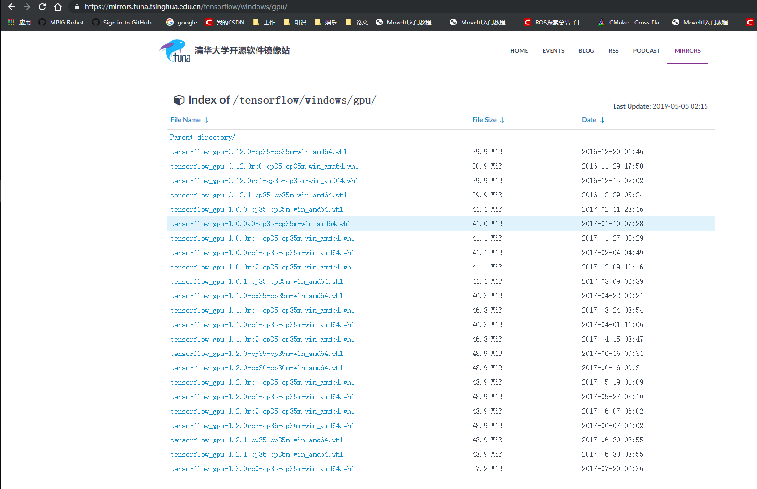
Install Python lib by hands!
> pip install xxx.whl

Slide 46
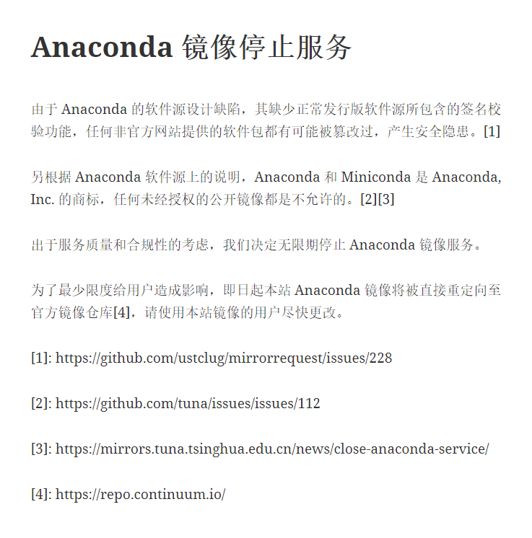
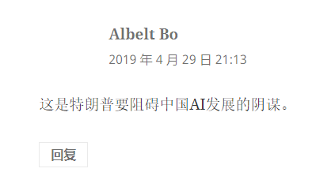
Sad

Slide 47
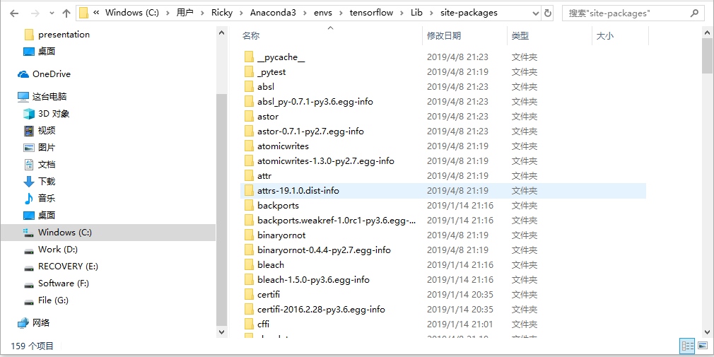
Install Python lib by hands!
Copy lib file to there directly.

Slide 48
3. Examples

Slide 49
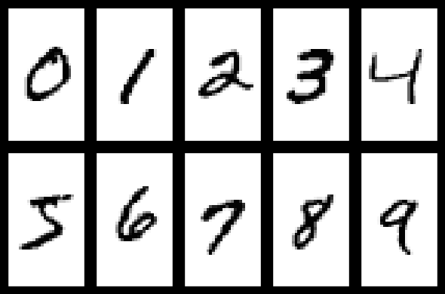
Examples
A Simple Linear Network
MNIST
LeNet(A CNN-b ased network)

Slide 50
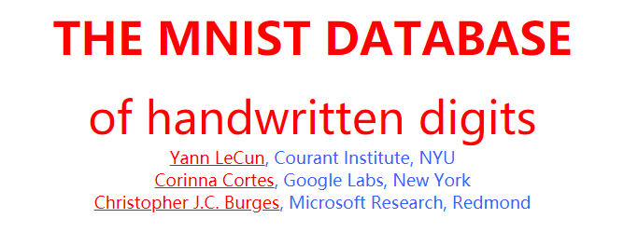
http://yann.lecun.com/exdb/mnist/
“Hello World” in Deep Learning
Training set images: train-images-idx3-ubyte.gz (9.9 MB, 60,000 samples)
Training set labels: train-labels-idx1-ubyte.gz (29 KB, include 60,000 labels)
Test set images: t10k-images-idx3-ubyte.gz (1.6 MB, include 10,000 samples)
Test set labels: t10k-labels-idx1-ubyte.gz (5KB, include 10,000 labels)

Slide 51
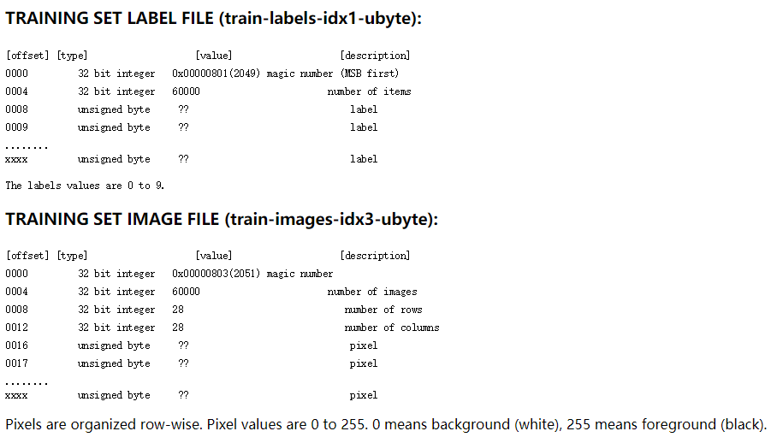
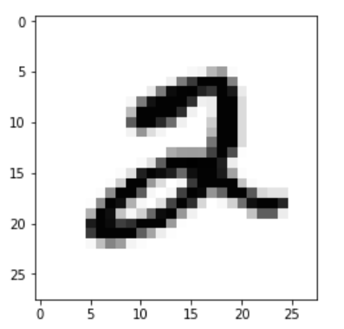

Slide 52
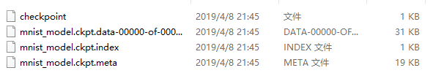

A Simple Linear Network
train
dataset
Restore
4
Detection

Slide 53
Talk is cheap, show the code.

Slide 54
PyTorch: Three Levels of Abstraction
Tensor: Imperative ndarray, but runs on GPU
Variable: Node in a computational graph; stores data and gradient
Module: A neural network layer; may store state or learnable weights
After version 0.4.0 merged

Slide 55
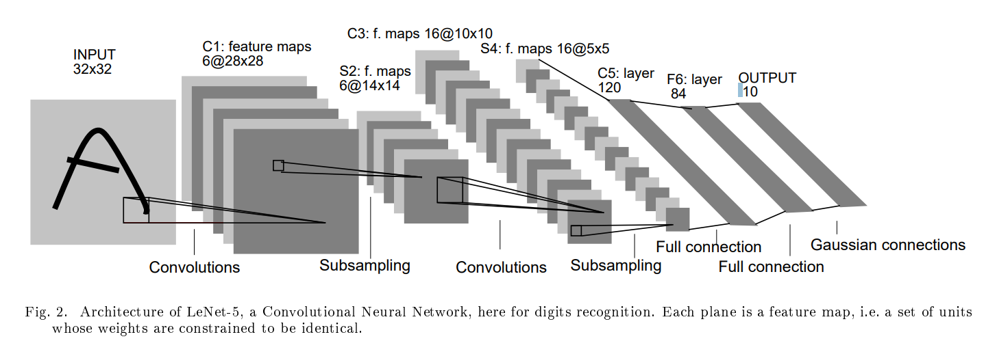
A Better Network: LeNet-5
1998

Slide 56
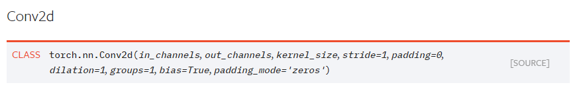

Slide 57
Talk is cheap, show the code.

Slide 58


